Slide 1
Project Storm
PROJECT FINANCE CASE STUDY
Valuing and financing the acquisition of a 50MW operational windfarm
Rosemary Waweru · Acquisition valuation as at 31 December 2012
Notes:
Project Storm is a project finance case study: valuing 100% of the equity in a 50MW operational windfarm from the perspective of an infrastructure investor, building the power price, debt sizing, tax and returns in one integrated model, and turning it into a bid recommendation.

Slide 2
A forced seller, a merchant asset
50MW
125GWh
15 yrs
2022
Operating since January 2008
Residual economic life, to 2027
Wind subsidy ends; fully merchant after
Annual output at P75 (2,500 hours)
The seller
The buyer
Balance-sheet constrained and unable to raise project finance. Must close by year end, and keeps the economic benefit of the asset to 31 December 2012.
An infrastructure investor targeting a 12% buy-and-hold equity IRR, with the option to sell down to a lower-return fund after a few years.
Project Storm · 02
Notes:
The setting: a distressed seller, an operating asset with no project finance on it, and a buyer who can bring the leverage the seller could not. The subsidy cliff in 2022 matters for everything that follows.

Slide 3
One model, price to equity value
01
02
03
04
05
Power price
Operations
Debt sizing
Tax
Valuation
Merit-order dispatch each year: the marginal plant sets the price. Real costs indexed to CPI.
P75 output, subsidy at CPI less 1.5% to 2022, fixed and variable costs at CPI plus 0.25%.
12-year senior debt sculpted to 1.30x DSCR, capped at 85% of fixed assets.
25% rate with a 30%-of-EBITDA interest cap. Debt, interest and tax solved together.
Dividends discounted at the 12% target, then stress-tested across seven scenarios.
Then the structuring questions: a PPA, an interest rate hedge, a subordinated loan and a two-year exit.
Project Storm · 03
Notes:
Each block feeds the next. The circularity between debt size, interest and tax is solved explicitly, with a live check in the model that reads nil.

Slide 4
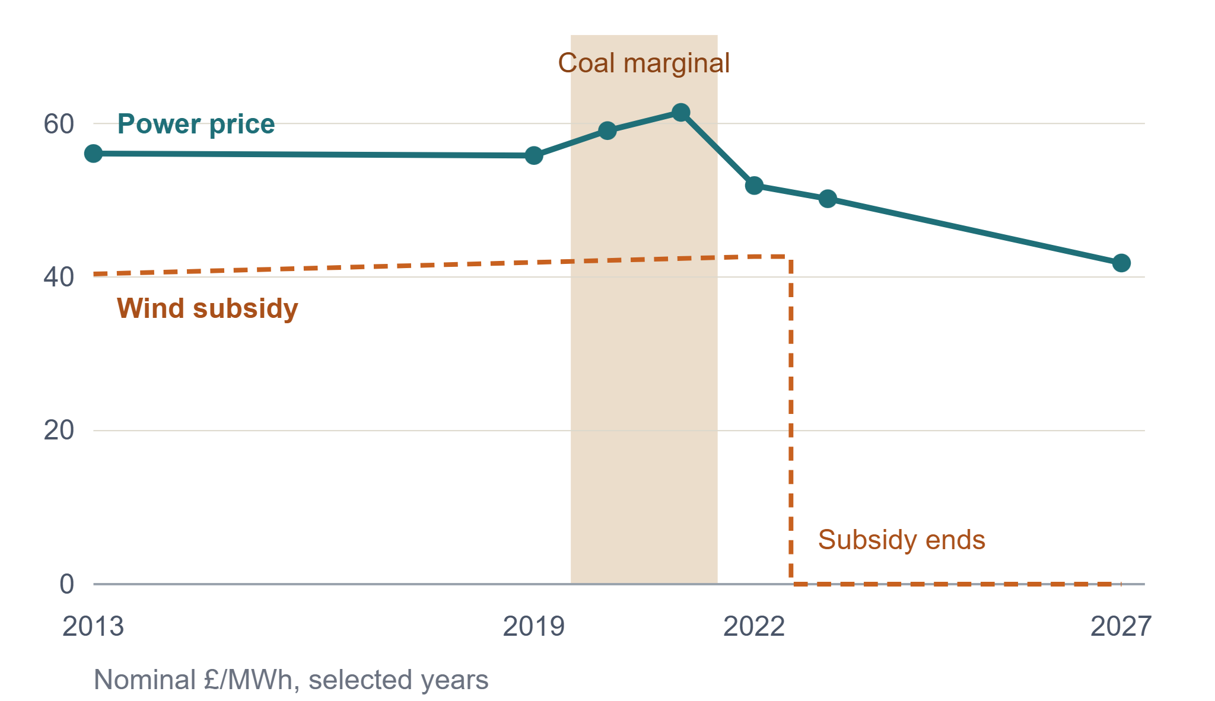
Power price: a moving merit order
A two-year coal hump
Coal costs escalate while CCGT costs fall. They cross in 2020, coal sets the price for two years, then retires. A static merit order misses this.
A subsidy cliff
The roughly £42/MWh subsidy ends after 2022, and EBITDA falls by about three-quarters.
Project Storm · 04
Notes:
Prices shown are nominal £/MWh for the years reported in the valuation memo: 56.09 in 2013, 55.83 in 2019, 59.07 and 61.45 in the coal years, 51.92 in 2022, 50.20 in 2023 and 41.84 in 2027. The full annual series sits in the model.

Slide 5
Debt capacity: the DSCR test binds
1.30x DSCR on P75 cash flow over 12 years
£51.2m
Binds
85% of fixed assets (loan-to-value)
£57.4m
Slack
£6.1m
84%
Circular
Leverage left on the table by the cover test
Gearing (debt to enterprise value)
Debt, interest and tax solved together; check reads nil
Project Storm · 05
Notes:
Two tests, the lower governs. Repayments are sculpted to a constant 1.30x cover, which maximises debt for a given cover level. Working capital is excluded from sizing. Because the DSCR test, not loan-to-value, is the constraint, anything that relaxes cover requirements — such as a PPA — converts directly into purchasing power.

Slide 6
Bid price: £64.5m for the equity
£64.5m
£'000
PV of dividends at 12% (equity cheque) | 14,800
Add: senior debt drawn | 51,242
Less: transaction costs | (500)
Less: upfront debt fee (2%) | (1,025)
Equity purchase price | 64,518
Less: cash acquired | (3,500)
Implied enterprise value | 61,018
Equity price at a 12.0% IRR, 1.81x multiple
£61.0m enterprise value
£1.22m per MW · 6.9x 2013 EBITDA · 5.8% unlevered project IRR
Dividends do not depend on the price paid, so the bid is solved directly rather than goal-sought.
Project Storm · 06
Notes:
The equity cheque is the present value of 2013–27 dividends at the 12% target. Add the debt the asset can carry, deduct costs, and the result is the price payable to the seller. That price is already £7.4m below the £71.9m book equity in the seller's accounts.

Slide 7
Key findings across the analysis
Analysis | Result | So what
Base-case bid | £64.5m equity · 12.0% IRR | £7.4m below the seller's book equity
P90 output for ten years | Equity IRR falls to 6.9% | 6% less volume removes 42% of the return
Sale to a fund after two years | 13.2% IRR (exit priced at 11%) | +120bps, from yield and deleveraging
Power purchase agreement | Break-even at ~4% discount | Value comes via extra debt, not revenue
LIBOR hedge, 85% amortising | 1.64% swap · 4.64% all-in | 44bps below a simple curve average
30% interest deductibility cap | Nil impact on price | The DSCR test caps debt first
5-year subordinated loan, 9% | 13.9% IRR (+195bps) | Or £0.8m more on price at 12%
Project Storm · 07
Notes:
One line per strand of the analysis. The swap is an amortising swap: the fixed rate is the notional-weighted average of LIBOR forwards, which sits below the simple average because the notional is largest when LIBOR is lowest. The subordinated loan is sized at 1.20x cover on five annuity payments; it is accretive because 9% sits below the 12% hurdle and the interest is tax-deductible.

Slide 8
The financing drives the value
LOWER THE DSCR FLOOR
MOVE THE HURDLE RATE
£1.9m
£2.3m
of price from moving cover from 1.30x to 1.15x
of price across a 400bps range, 10% to 14%
A 0.15x change in lender cover is worth almost as much as 400bps of required return. That is why a PPA, which lets lenders size at 1.15–1.20x, is the most important lever on price.
Project Storm · 08
Notes:
Sensitivity of the bid to the equity hurdle: 10% gives £65.8m, 14% gives £63.4m. A PPA struck at the forward curve with a 1.15x floor supports £66.4m; each 5% of discount to the curve costs roughly £2.5m, so the break-even discount is about 4%.

Slide 9
Downside risk is asymmetric
Scenario, at a £64.5m price | Equity IRR | Min DSCR | Outcome
Base case (P75) | 12.0% | 1.30x | On plan
P90 for ten years, then P75 | 6.9% | 1.21x | Lock-up risk
Operating costs +10% | 8.3% | 1.02x | Covenant breach
Power price −5% | 8.7% | 1.10x | Covenant breach
P90 every year | 6.0% | 1.09x | Covenant breach
Power price −10% | 4.8% | 0.89x | Payment default
Power price −10% and P90 | (3.5%) | 0.70x | Equity written off
A 10% price rise gives 17.7%. A 10% fall is a default, not just a lower return.
Project Storm · 09
Notes:
Price and committed debt held constant, operating case shocked. At 84% gearing the lenders take the cash before the equity sees any of it, so the distribution of outcomes is wide and skewed to the downside.

Slide 10
Recommendation
01
02
03
Bid £64.5m as a ceiling; open nearer £60m
Settle the financing before the price
Go higher only with a PPA or lower cover
The seller cannot raise finance and must close by year end. The price is already £7.4m below their book equity.
The DSCR test, not loan-to-value, caps the debt. Negotiate cover levels and a 1.15x lock-up before price.
At 84% gearing the equity is thin. Without contracted revenue, more price means more default risk.
BEFORE BIDDING
Actual load factor against P75 since 2008 · decommissioning liability (~£0.5m PV) · subsidy grandfathering to 2022 · share versus asset purchase and capital allowances
Project Storm · 10
Notes:
The debt does the work. Treat £64.5m as a walk-away price, lead the negotiation on financing terms, and only stretch beyond it if contracted revenue or lower cover requirements make the extra leverage safe. Technical diligence on the actual load factor matters most: P75 is the whole valuation.

